Slide 1
Operating system Lecture eight part2
Dr jamal altuwaijari

Slide 2
8.7 Synchronization hardware
The feature of the h/w can make the programming task easier and improve system efficiency. The critical- section problem could be solved simply in as uniprocessor environment if we could disallow interrupts to occur while a shared variable is being modified. Many machines therefore provide special h/w instructions that allow us either to lest and modify the content of a word or to swap the contents of two words.
We can use these special instructions to solve the critical section peoblem.

Slide 3
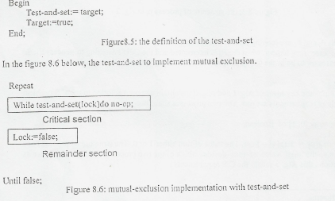
8.7.1. the test- and set instruction
Can be defined as shorn in the tigure8.5 below, where we can implement mutual exclusion by declaring a Boolean -variable lock initialized to false. Function test-and-set (Var target Boolean): Boolean;

Slide 4
8.7.2 Semaphores
Another solution to the critical • section problem is the using a synchronization tool called a
Semaphore.
A semaphore S is integer variable that a part from initialization is accessed only through two standard atomic operations: wait and signal. These operations were originally termed p (for wait from proberen to test) and V (for signal from verhogen to increment).
The classical definitions of wait and signal are:
Wait (S): w Nile S <= 0 do no-op;
S:=S-1:
Signal(S): S:= S +1;
Modification to the integer value Of the semaphore in the wait and signal operation must he executed indivisibly. That is when one process modifies the semaphore value no other process, - can at the some time modify that same semaphore value. In addition in the case of wait(S) the testing instructions(S<=0) and(S:=S-I ) must also be executed without interruption

Slide 5
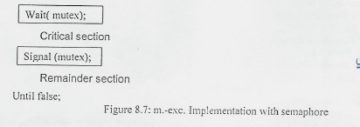
The semaphore usage
We can use semaphores to deal with the n-process critical-section problem. The n-processes share a semaphore mutes (for mutual exclusion) initialized to I.
Each process pi is organized as the figurc8.7.
Repeat.

Slide 6
Example (1): Consider two concurrently running processes: pi with a statement Si and P1 with a statement S•. Suppose that we xan implement this scheme by letting Pi and Pi share a common semaphore synch initialized to 0 and by inserting the statements in process PI.

Slide 7
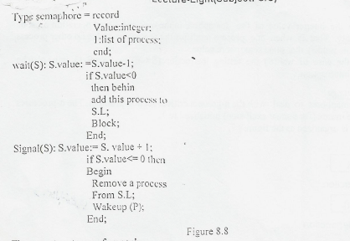
Example(2):
The main disadvantage of mutual-excl. solutions defined previously is that they all require busy waiting. The busy wailing wastes CPU cycles that some other process might be able to use the CPU. To overcome the need for busy waiting we can modify the definition the wait and signal semaphore operations. To implement semaphores under this definition we define a semaphore as a record: Each semaphore has an integer value and a list of processes .when a process must wait on a semaphore it is added to the list processes. A signal operation removes one process from the list of waiting processes' and awakens that process . the semaphore -operations-can now be defined as in the figure 8.8.

Slide 8
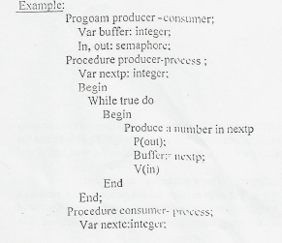
There are two types of semaphores:
a. binary semaphores: can assume only the value 0 or the value I. b.Counting semaphores(also called general semaphores ) can assume only non negative integer values.
This type of semaphores are useful when a resource is to be allocated from a pool of identical resources. The semaphore is initialized to the number of resources in the pool. 'Where process P decrements the semaphore by 1, and process V increments by I

Slide 9
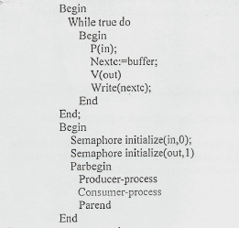

Slide 10
8.8.Concurrent programming:
Concurrent programming is much more difficult than sequential programming. Concurrent programs are harder to write debug, modify and prove correct. Concurrent programming is very important today because it enable us to express solutions more naturally to certain kinds of problems that are related to paralley hardware architectures such as multi processors and distributed systems.

Slide 11
Monitors
A monitor is a concurrency that contains both data and procedures needed to perform allocation of particular serially reusable shared resource or group of serially reusable shared resources.
A monitor is defined by set of programmer- defined operators, and the
representation of a monitor types consists of:
a. declaration of a variables whose VAUCS define the state of an instance of the type.
b. The bodies of procedures of functions that implement operations on the type

Slide 12
Monitors
c. The syntax of monitor is.
Type monitor-nme=monitor
Variable declarations
Procedure entry P1(...);
Begin...end; Procedure entry P2(...);
Begin...end;
Procedure entry P2.(...);
Begin... end;
Begin
Initialization code
End

Slide 13
Monitors
A procedure defined within monitor can access only those variables declared locally within the monitor and the format parameters. Where there is no way for processes outside the monitor to access monitor data.
The monitor construct ensures that only one process at a time can be active within the monitor' the monitor resources additional construct used for synchronization called condition construct.
Example
Var;
x,y: condition
The only operations that can be involved on a condition variable are wait and signal
x.wait;
means that the process invoking this operation is suspended until another process invokes.
x.signal;
The x.signal' operation resumes exactly one suspended process. If on such process then the signal operation has no effect that is the stare of x is as though the operation was never executed. The schematic view of a monitor with condition variables as in the figure 8.9 below.

Slide 14
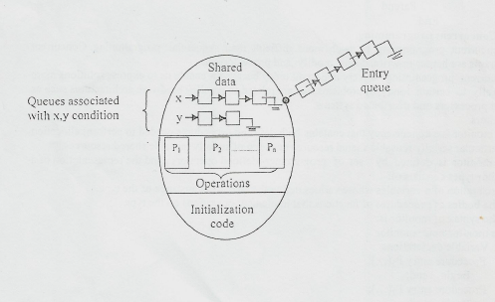
Monitors
The wait and signal operations arc modified to include the name of the condition variable being waited or signaled.
Figure 8.9: Monitor with conditions variables
Wait (condition variable name)
Signal(condition variable name)
When a condition variable is defined a queue is established a process calling wait is threaded into the queue, a process calling a signal causes a waiting process to remove from the queue and to enter the monitor

Slide 15
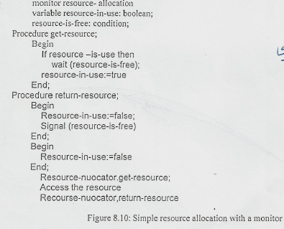
Simple resource allocation with monitors
Suppose several processes need access to a certain resource that may be used be only one process at a time.
A simple monitor for handling the assignment and disassignment of such a resource as described below, in figure 8.10.

